Slide 1

Neon Ravens
Rise in the Night
Bricke Volckeryck – Martin Ropartz – Yebin Son – JongYeon Bae – Sem Demoen

Slide 2
Name
Professional fictional esports team
Active in FPS & MOBA games
Neon cyber aesthetic
Goal: dominate the esports arena

Slide 3
Introduction
Professional fictional esports team
Active in FPS & MOBA games
Neon cyber aesthetic
Goal: dominate the esports arena

Slide 4
Team / Roster
Zephyr – ADC (TOP PLAYER)
Kuno – Mid
Mok – Support
Rook – Top

Slide 5
Schedule and Competitions
Next Match: Neon Ravens vs. Aurora Flux
Date: Nov 29, 2025
19:00 CET
New Merch drop at event!

Slide 6
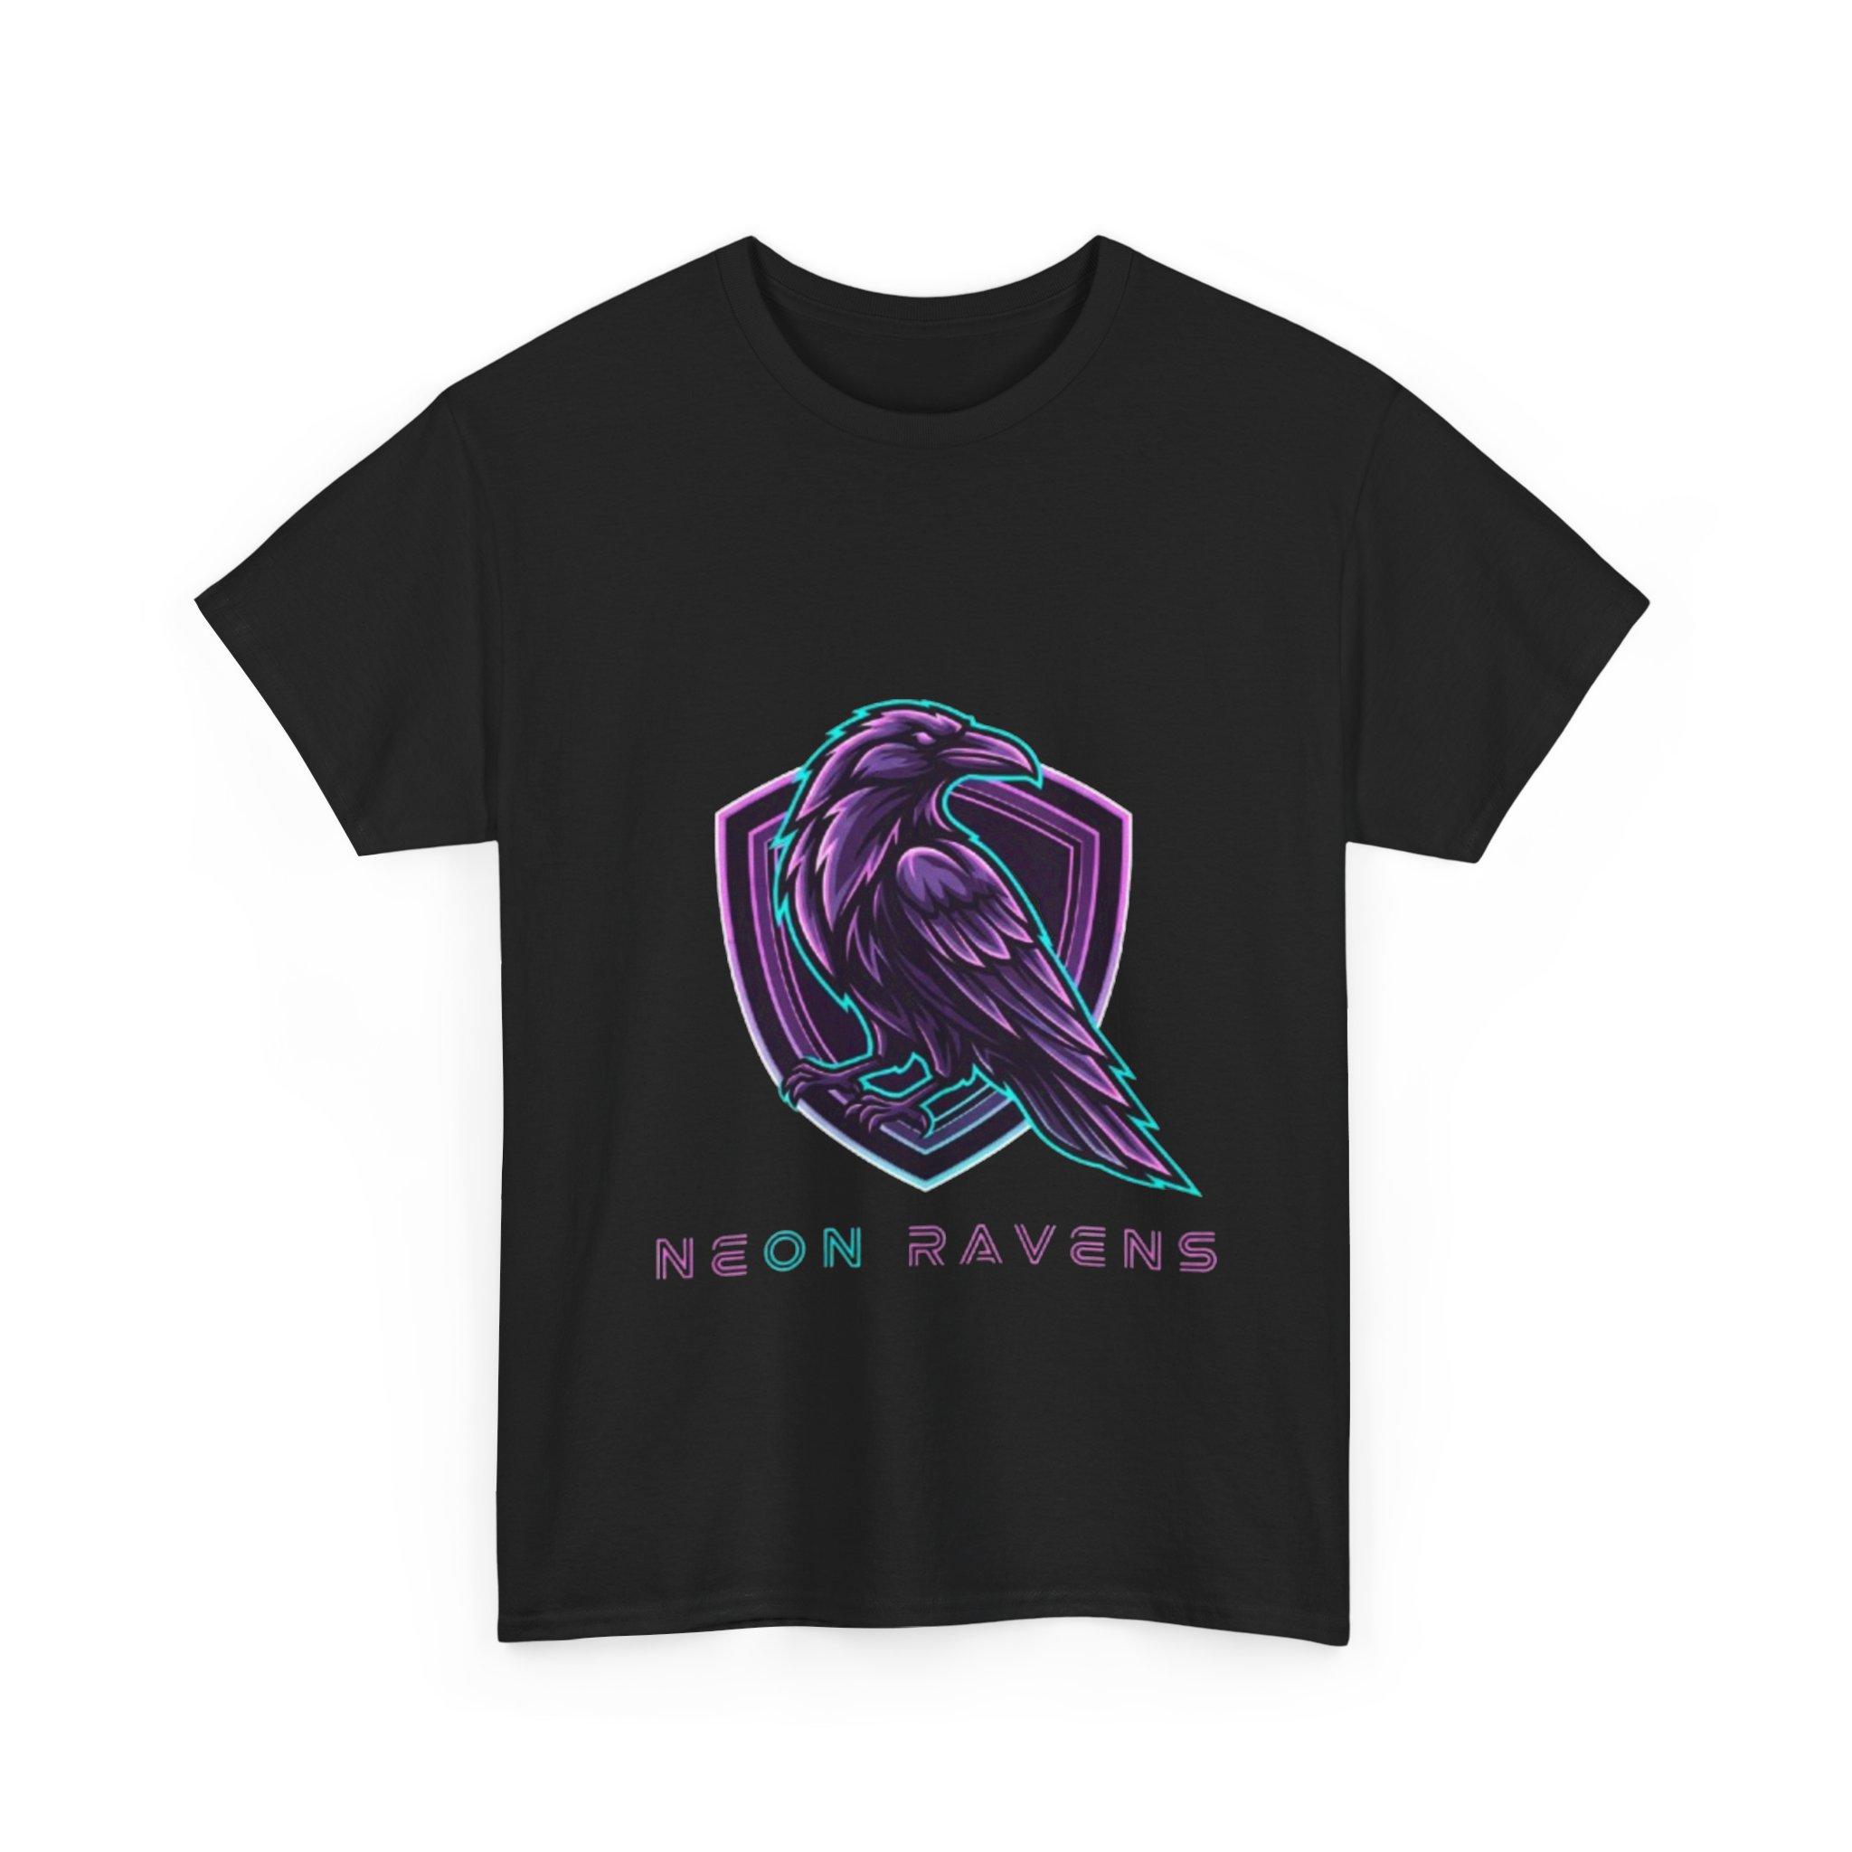
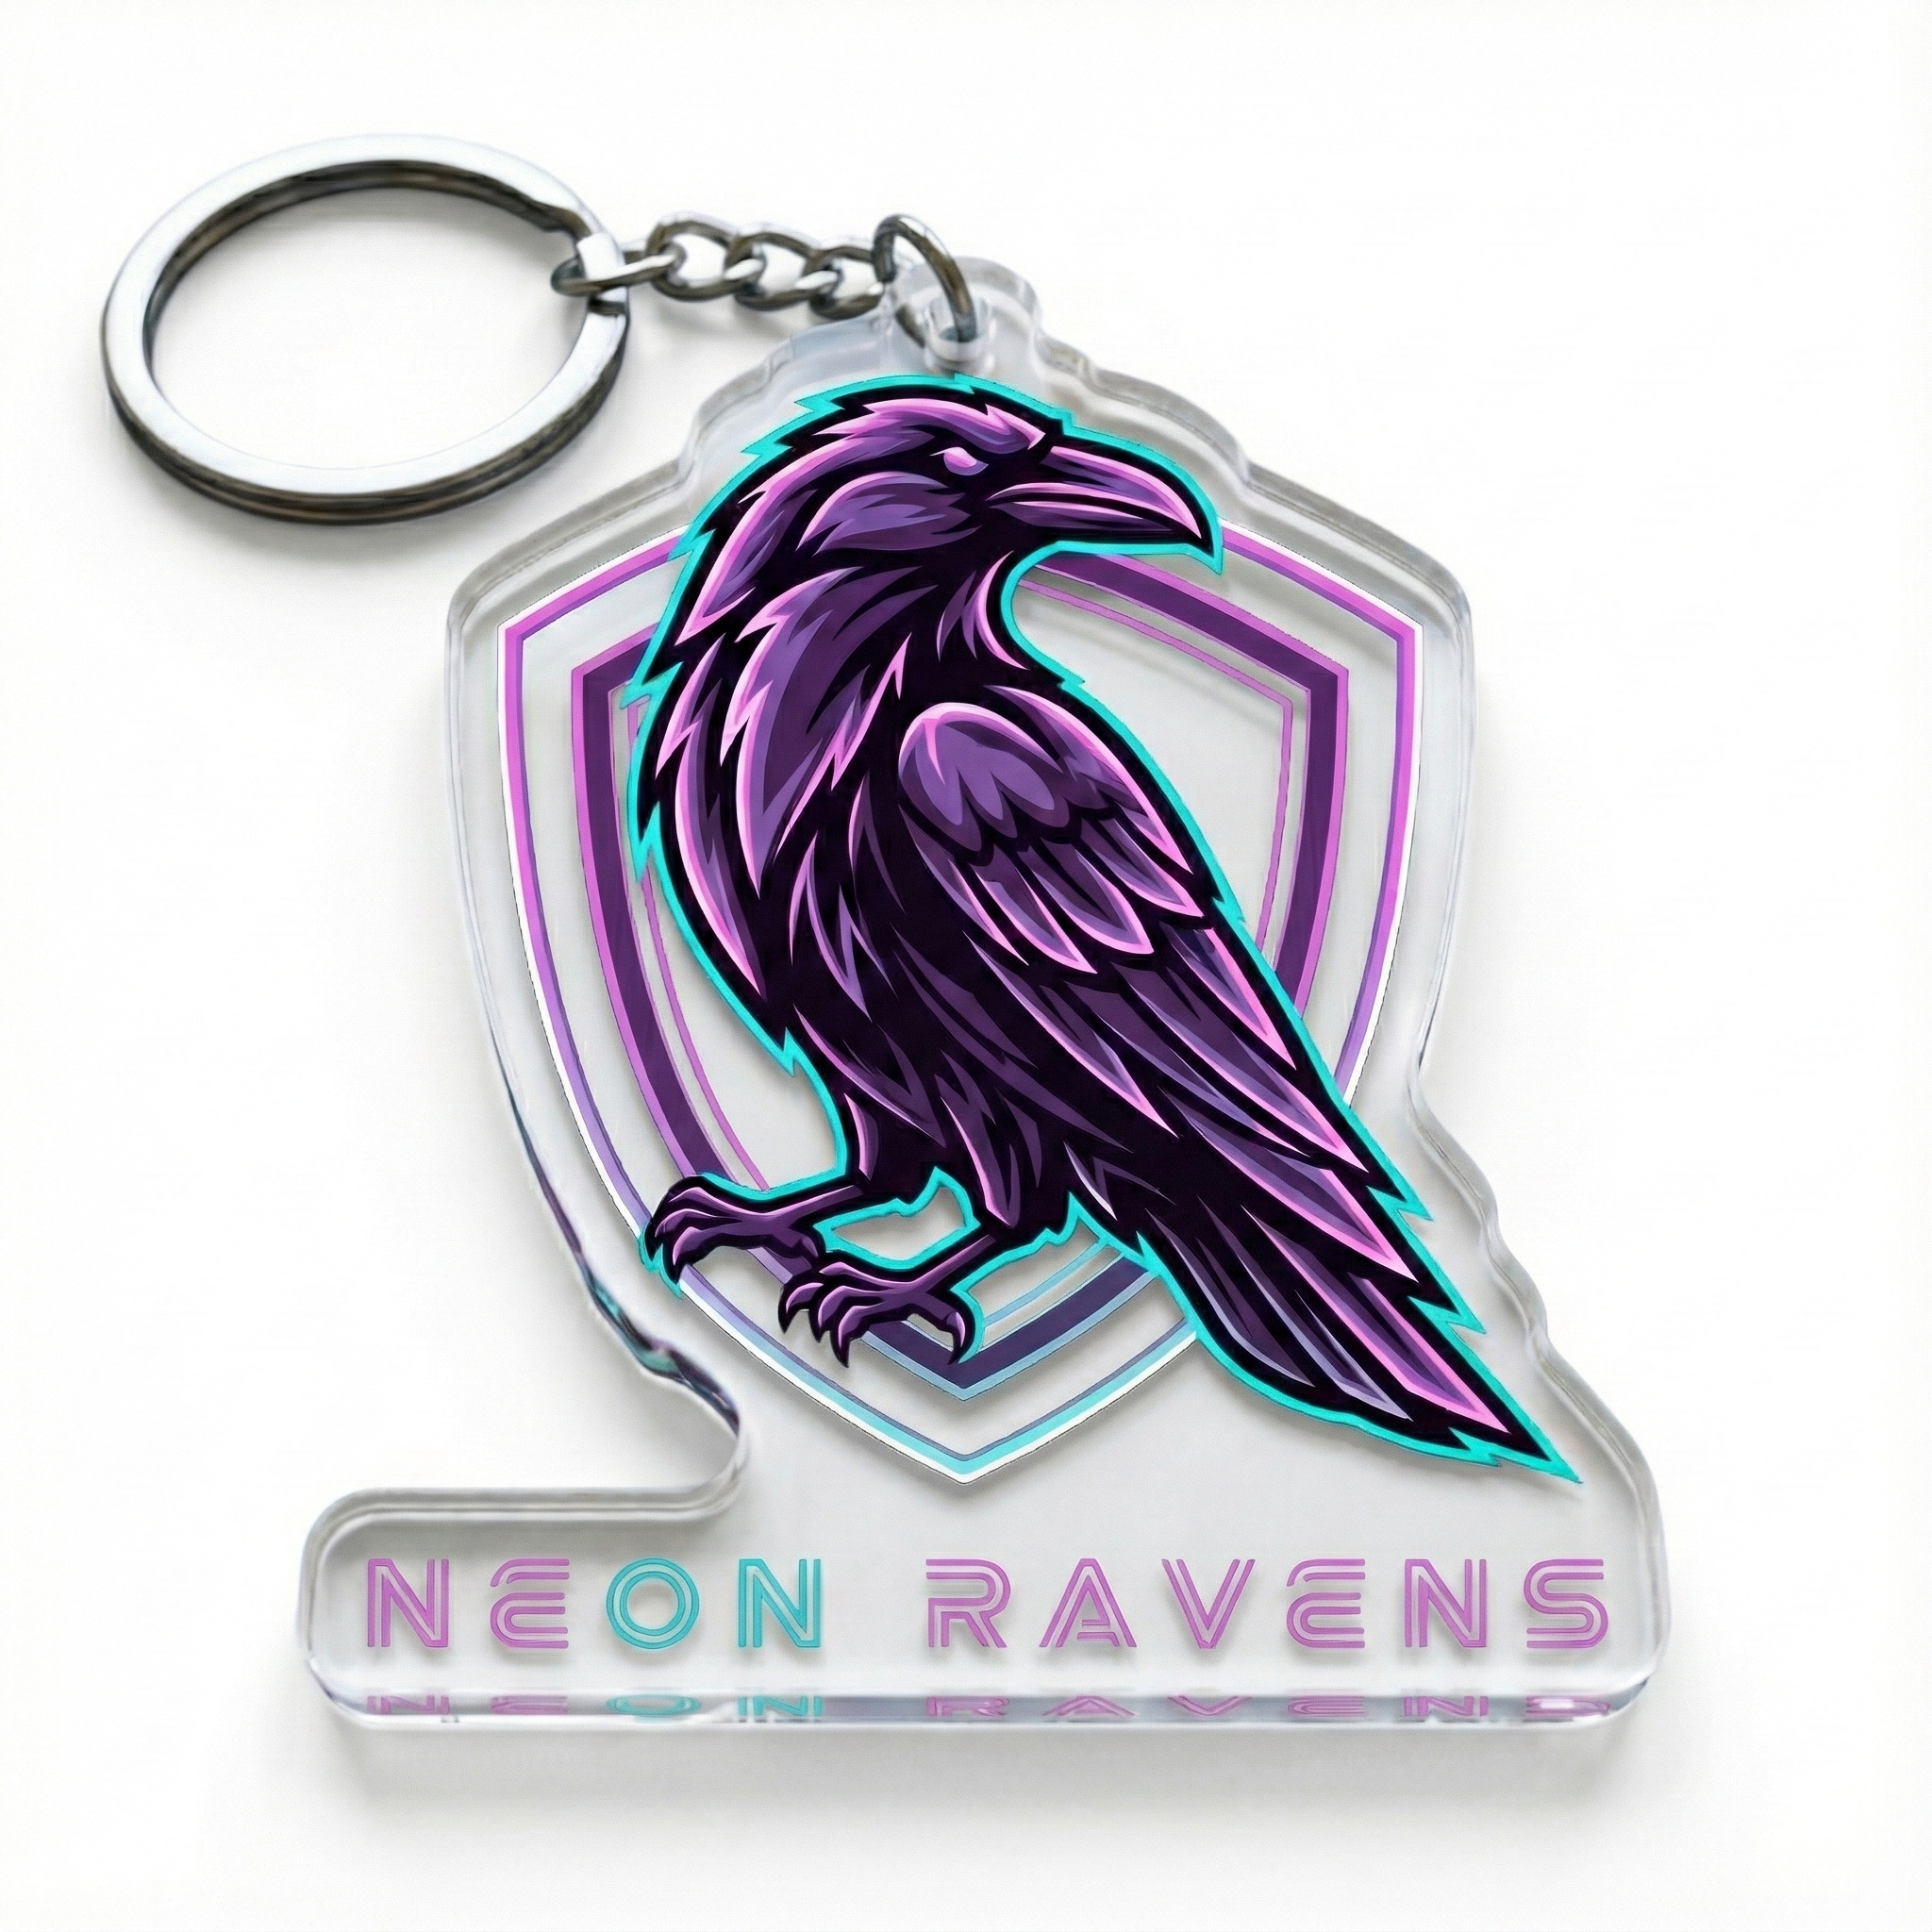
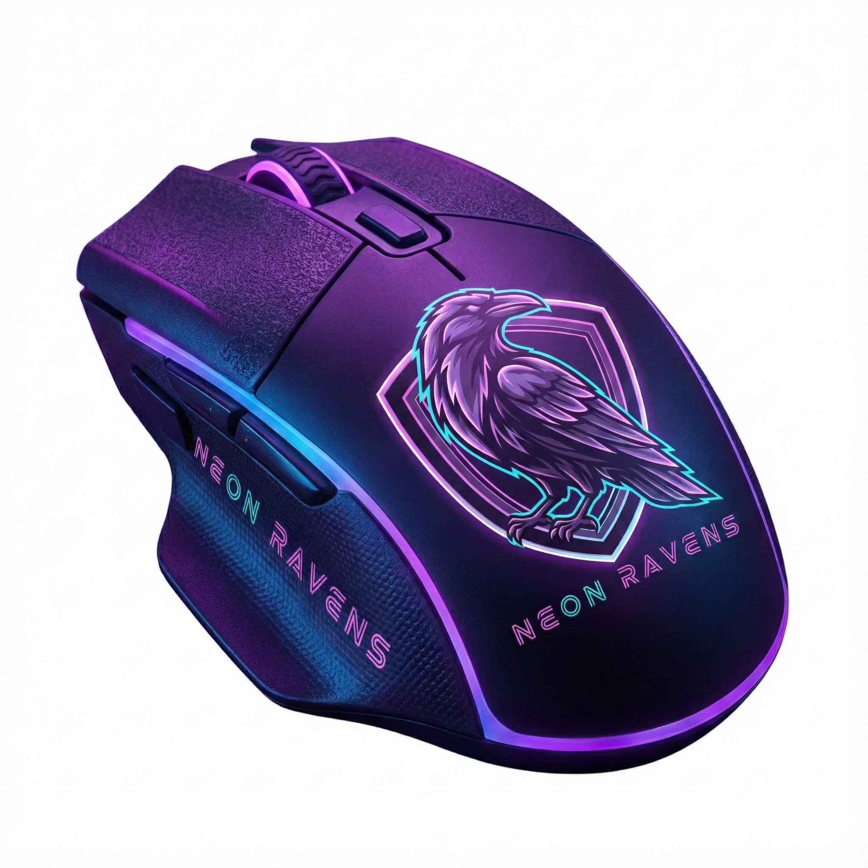
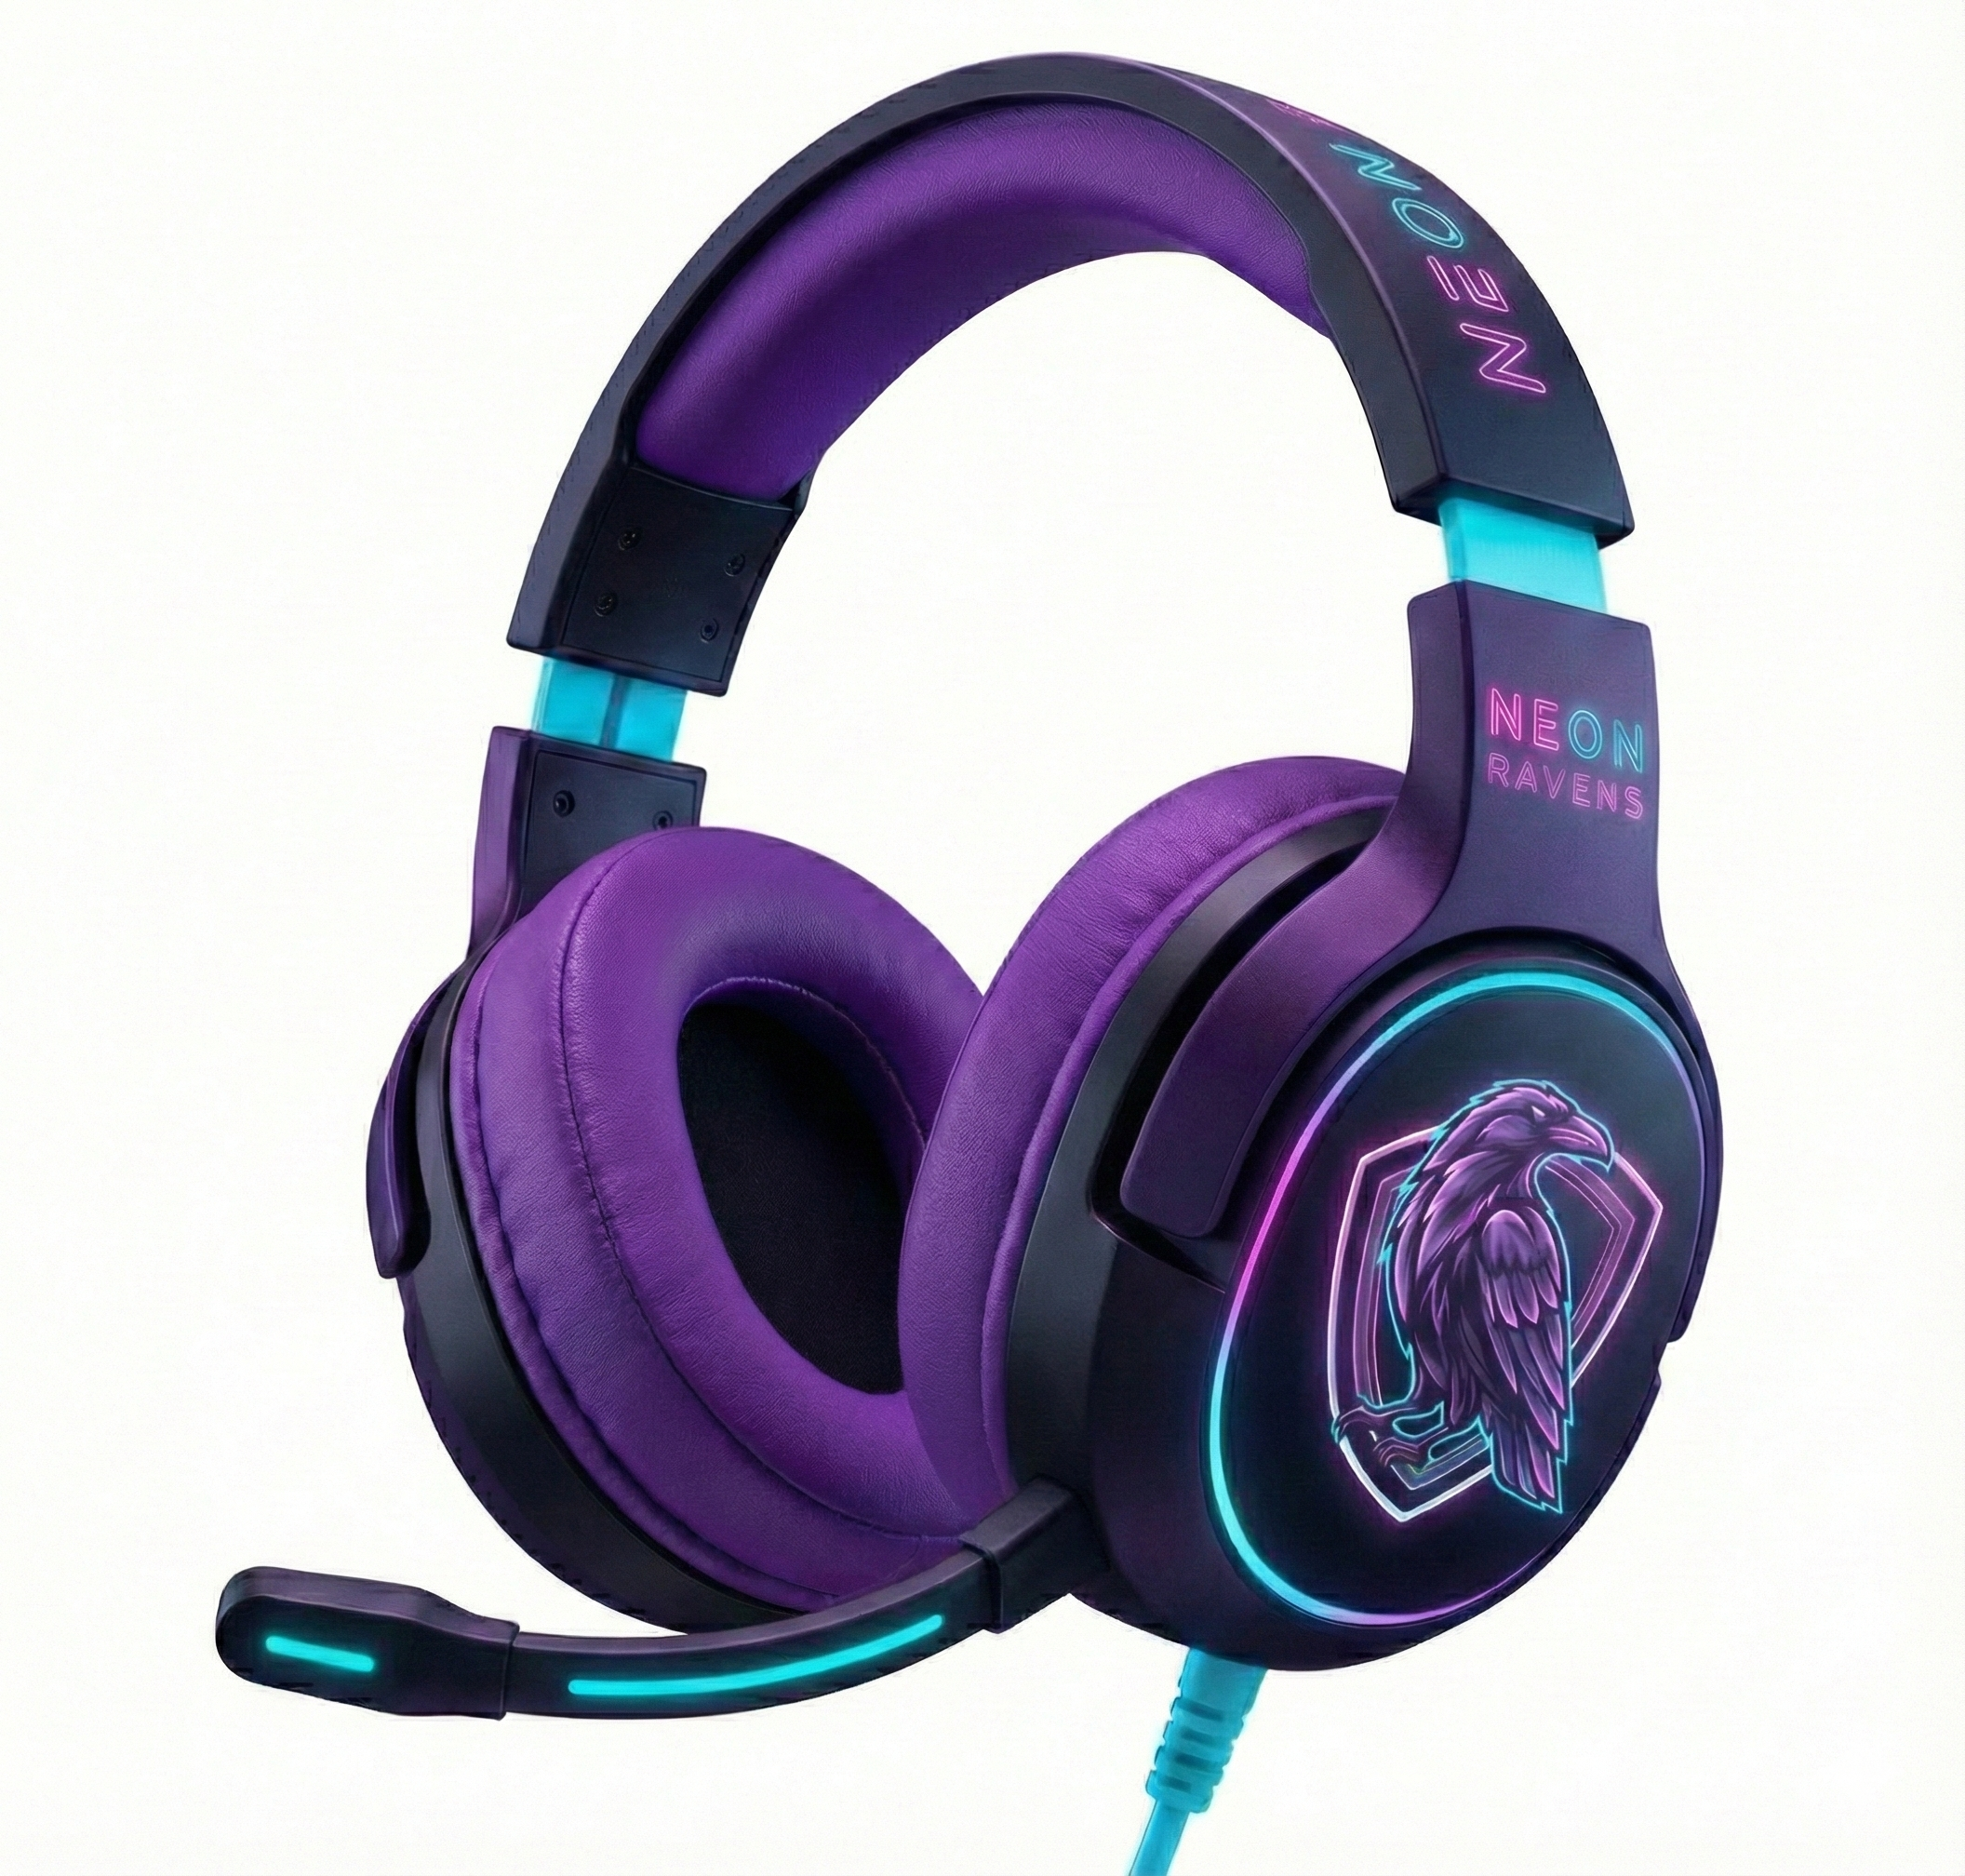
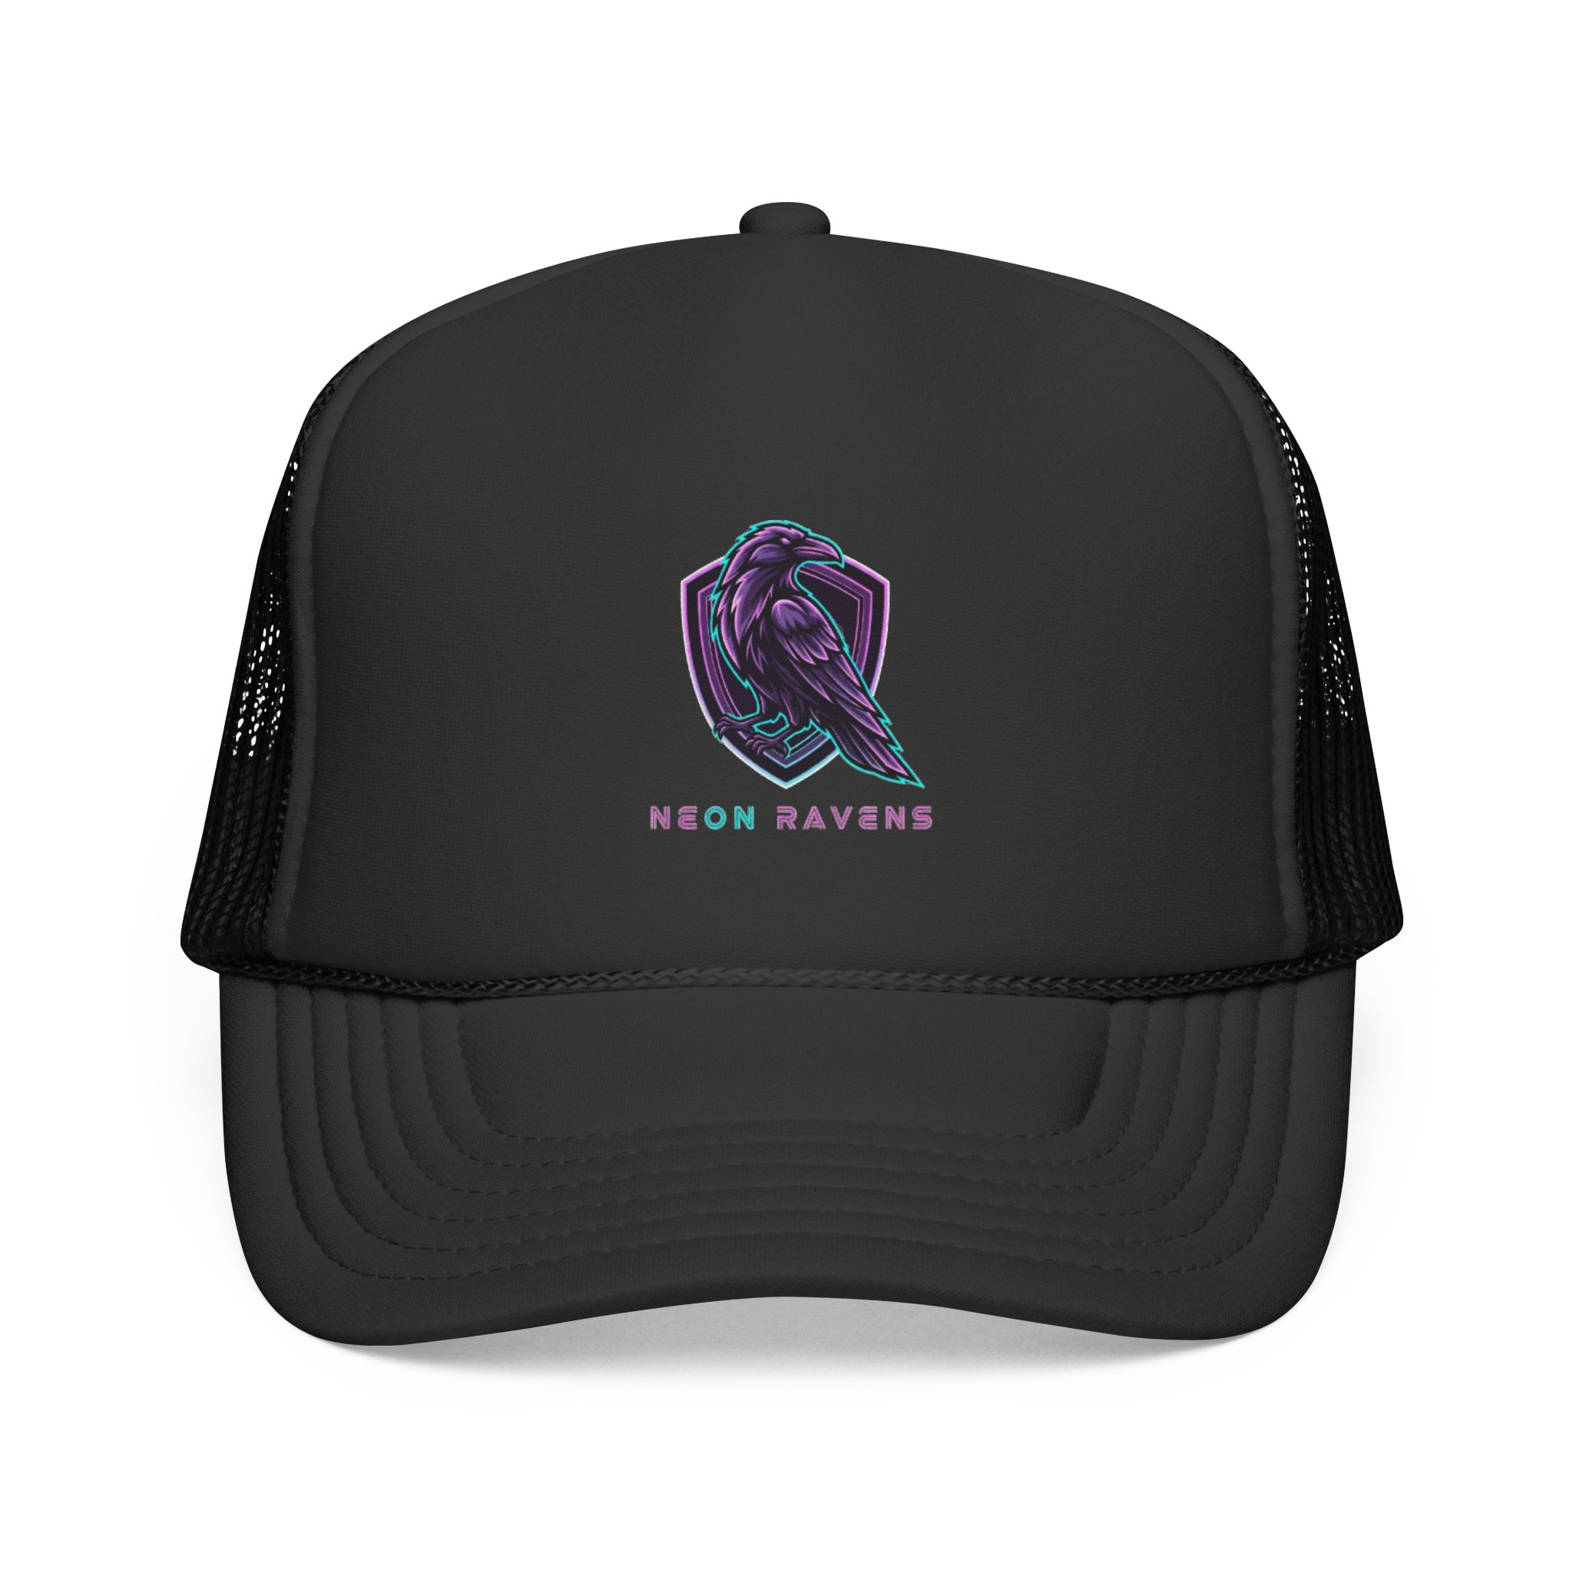
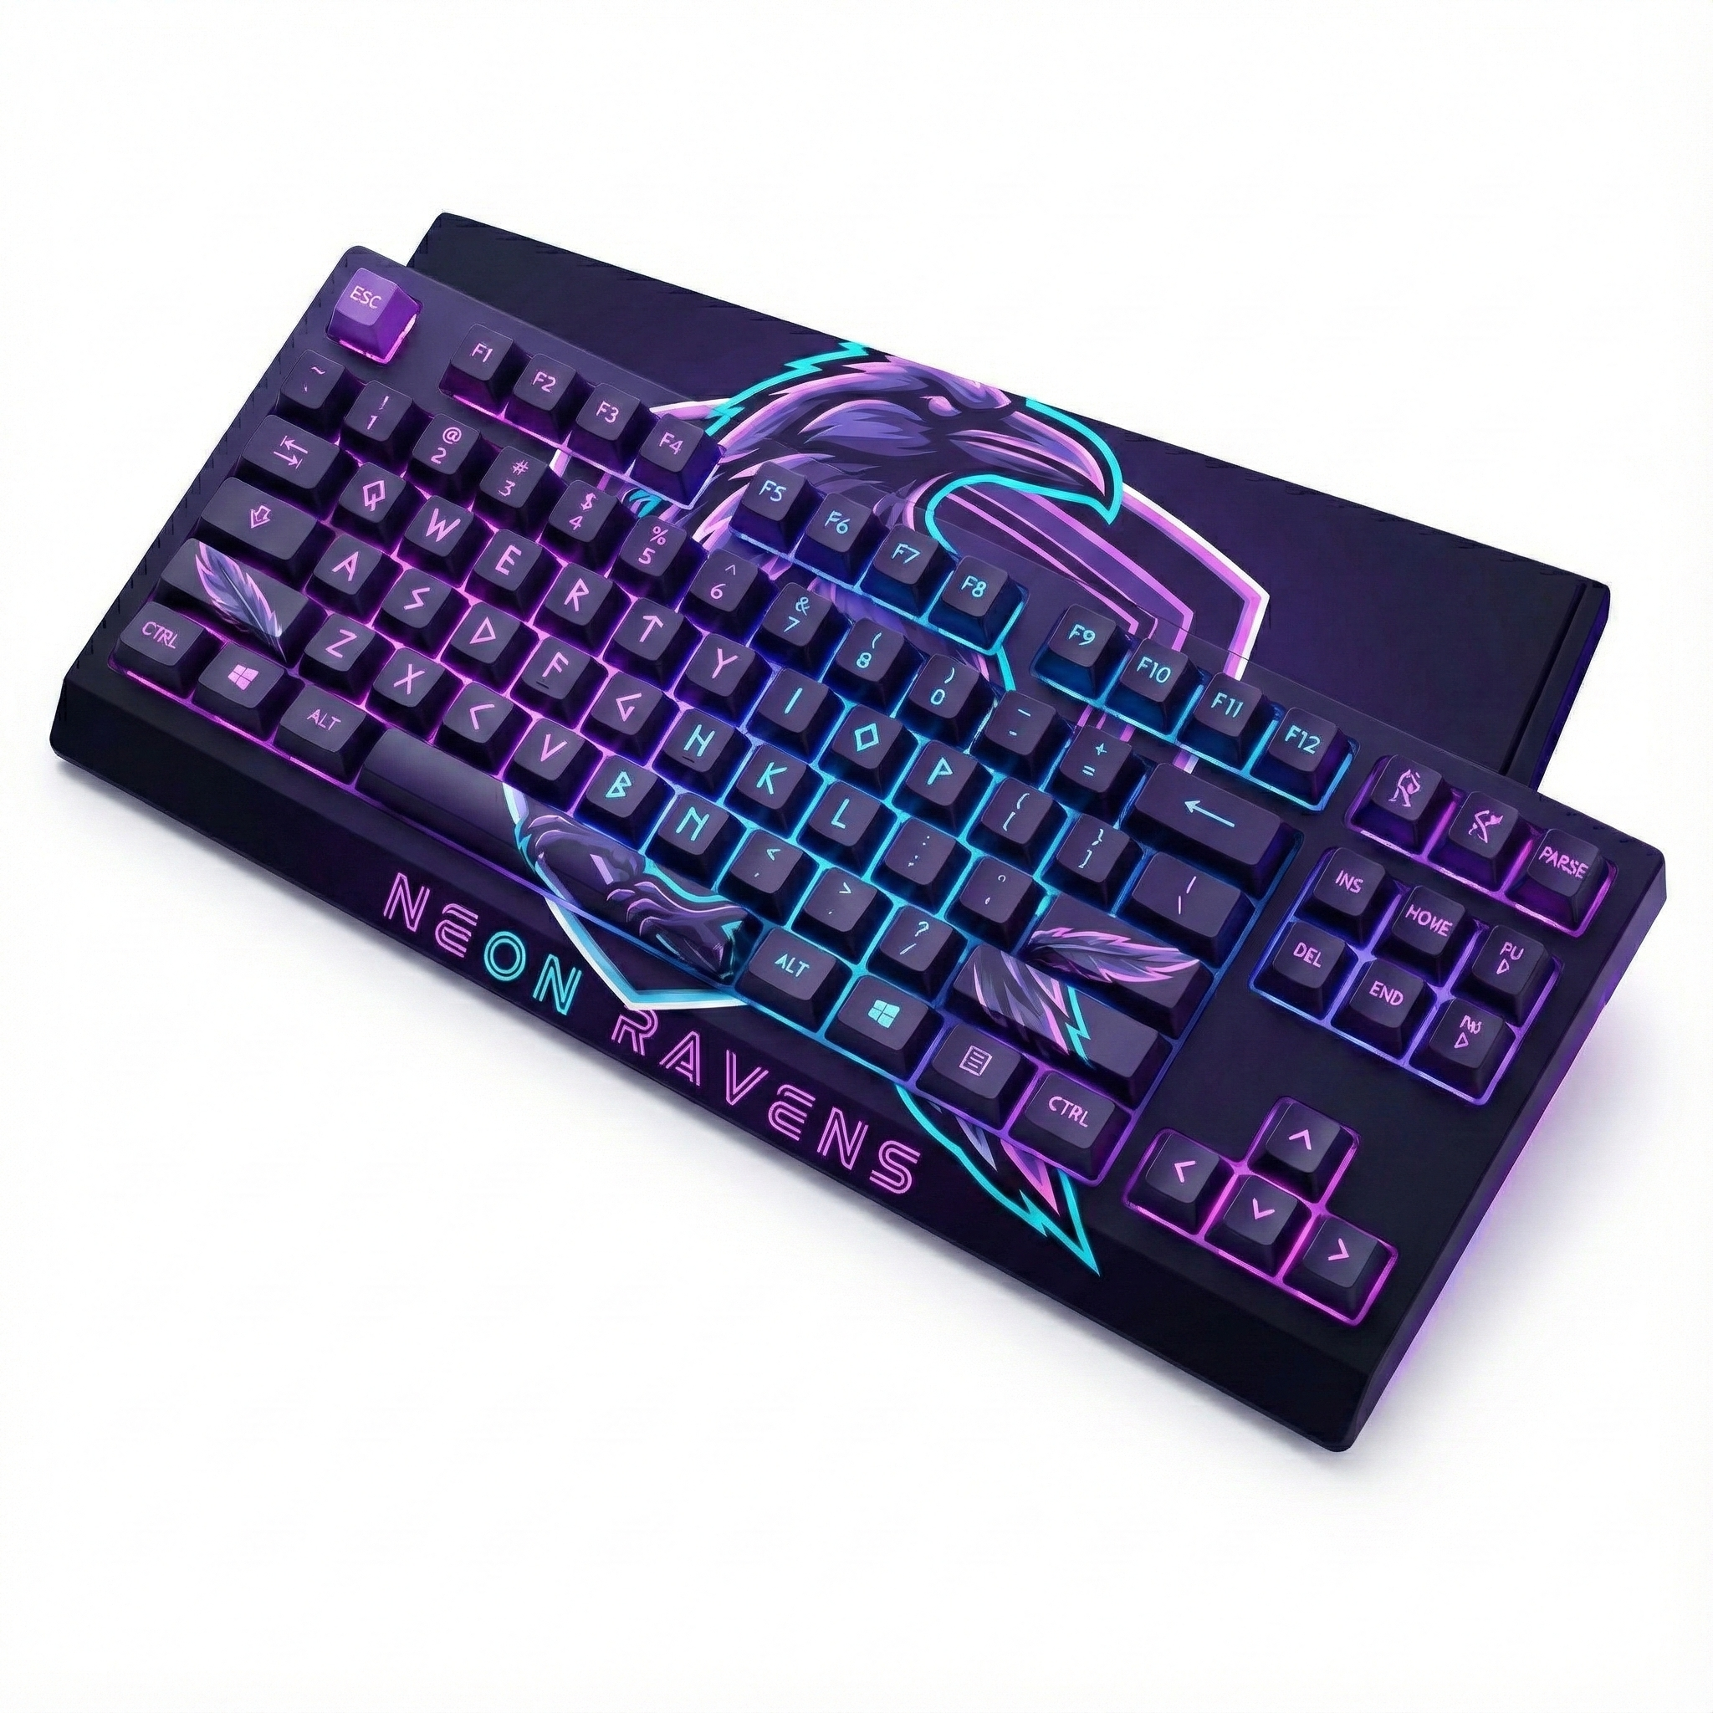
Merch

Slide 7
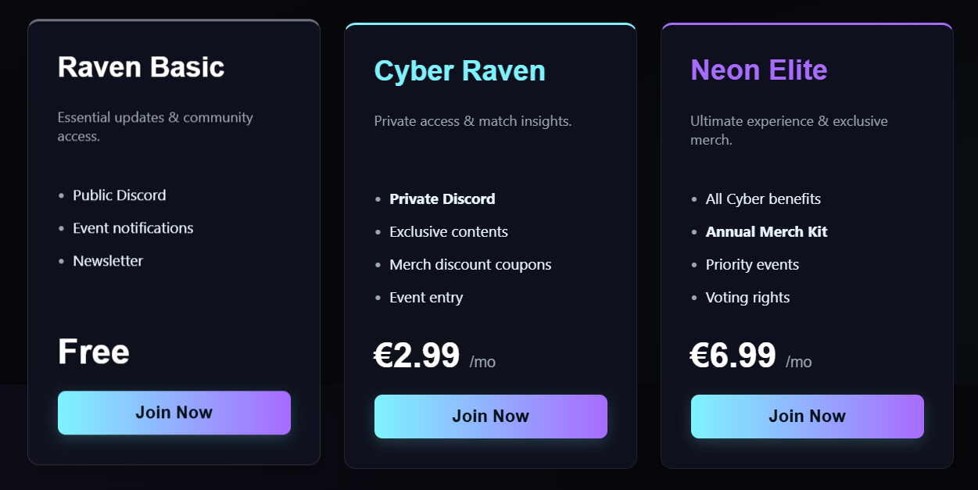
Community

Slide 8
Selling points
Strong brand identity
Professional style
Neon cyber look
Competitive players

Slide 9

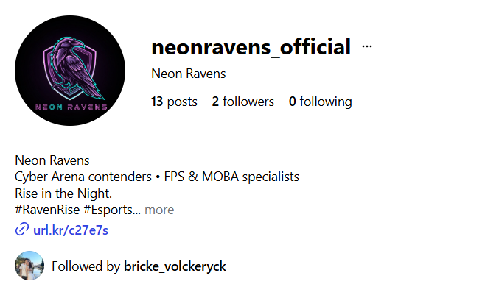
Socials
@neonravens_official

Slide 10
See you in
the Arena!
-- Thank you for your attention --

